Slide 1

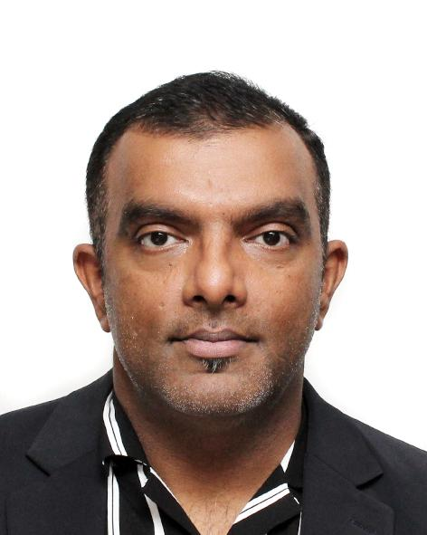
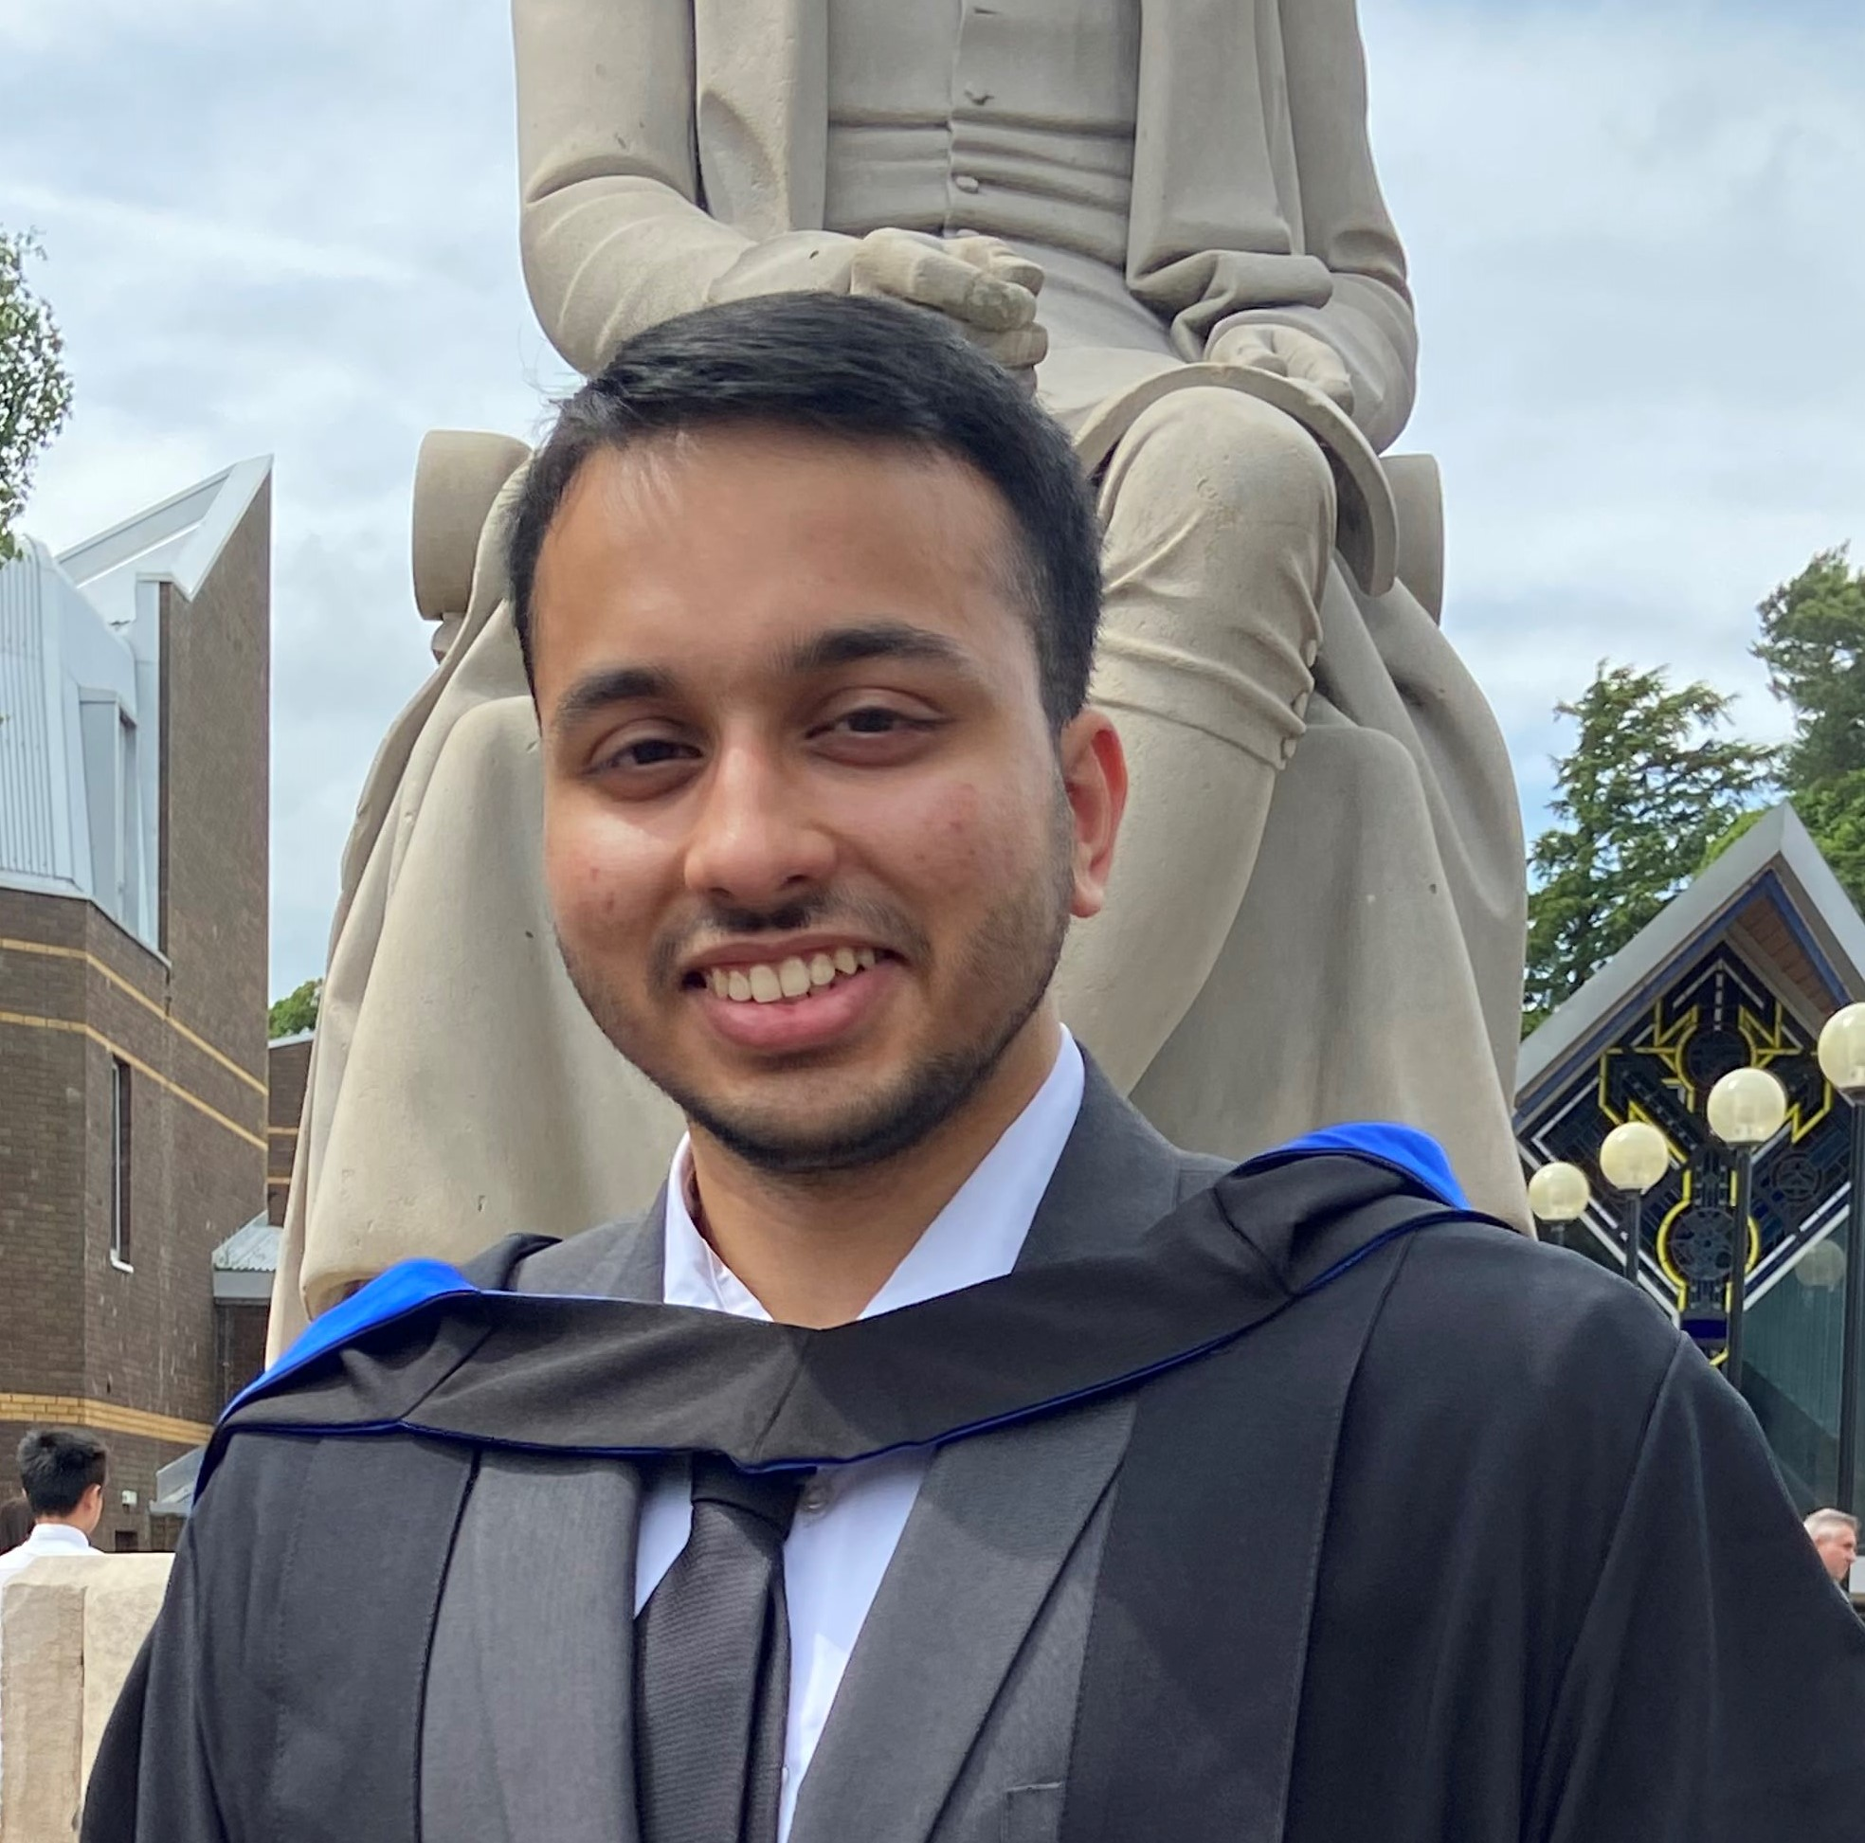
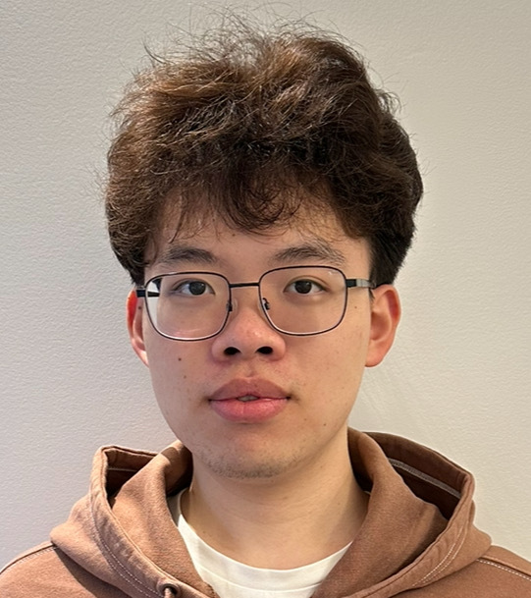

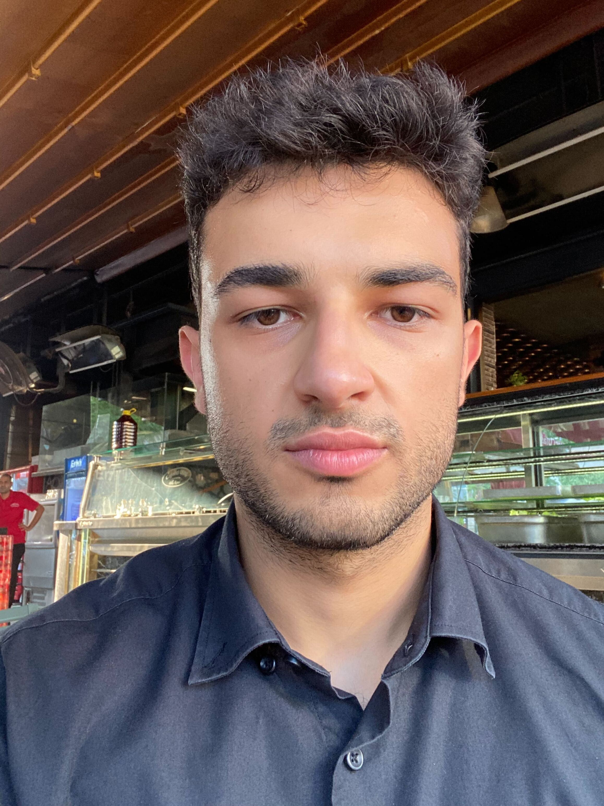
Intelligent Urban Tree
Analysis Project
COMP90024 2024 Semester 1 Assignment 2
TREEINSIGHTS | Team 4
Saad Sheikh
Pranav Pai
Rongcong Lin
Abhigyan Singh
Kaan Gocmen

Slide 2
Scenarios
Scenario 1 - Overview of Urban Forest Plan
Scenario 2 - One of the benefits of urban forest: Oxygen Production
Scenario 3 - Useful Tree life prediction model
Scenario 4 - Useful Tree life prediction model

Slide 3
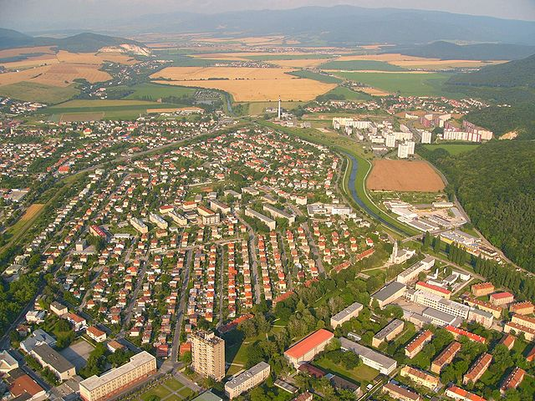
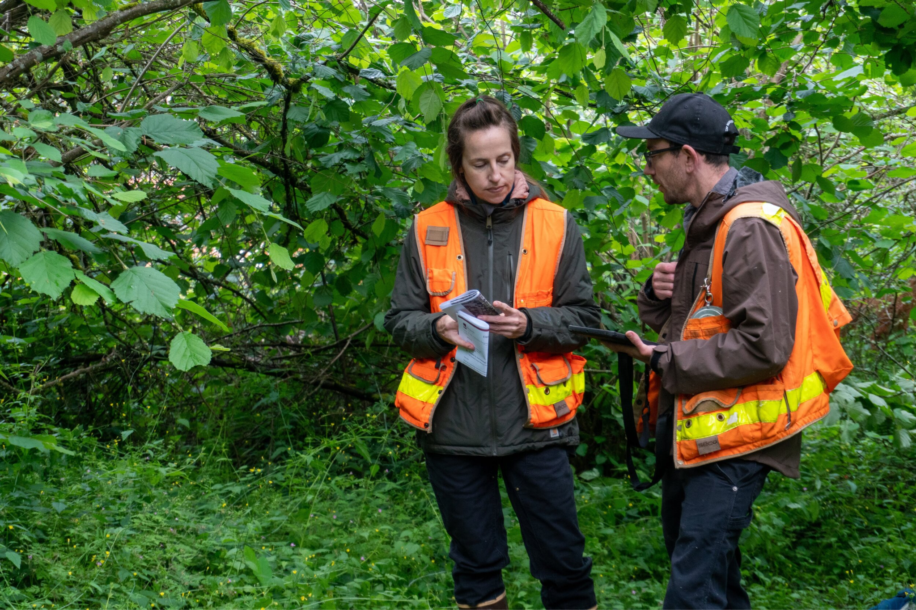
Conclusion
Who can use these analysis and tools?
City Planners and Urban Developers.
Environmental Scientists and Ecologists.
Public Health Officials and Community Advocates.
Arborists and Urban Forestry Managers.
[1]
[2]

Slide 4
~THANK YOU~

